Slide 1


Han, Sijia
July 26, 2024

Slide 2

Outline
Executive Summary
Introduction
Methodology
Results
Conclusion
Appendix

Slide 3
Executive Summary
Summary of methodologies
Data Collections
Data Wrangling
Exploratory Data Analysis
Interactive Visual Analytics
Machine Learning Prediction Analysis
Summary of all results
Launch success has improved over time.
KSC LC-39A has the highest success rate among landing sites.
Orbits ES-L1, GEO, HEO, and SSO have a 100% success rate.
Most launch sites are near the equator, and all are close to the coast.
All models performed similarly on the test set. The decision tree model slightly outperformed.

Slide 4
Introduction
Project background and context
SpaceX, a trailblazer in the space industry, is committed to making space travel accessible and affordable for everyone. Its remarkable achievements include sending spacecraft to the International Space Station, launching a satellite constellation to provide global internet access, and conducting manned missions to space. SpaceX's success largely stems from its innovative reuse of the first stage of its Falcon 9 rocket, which significantly reduces launch costs to approximately $62 million per launch. In contrast, other providers who do not have the capability to reuse the first stage face costs upwards of $165 million per launch. By determining the likelihood of a successful first-stage landing, we can estimate the launch price. Public data and machine learning models can be utilized to predict whether SpaceX or a competing company can reuse the first stage, thereby impacting overall costs.
Problems we want to find answers
How payload mass, launch site, number of flights, and orbits affect first-stage landing success
Rate of successful landings over time
Best predictive model for successful landing (binary classification)

Slide 5

Section 1

Slide 6
Methodology
Executive Summary
Data collection methodology:
Using SpaceX REST API and web scraping techniques
Perform data wrangling
Filtering the data, handling missing values and applying one hot encoding
Perform exploratory data analysis (EDA) using visualization and SQL
Perform interactive visual analytics using Folium and Plotly Dash
Perform predictive analysis using classification models
Predict landing outcomes using classification models.
Tune and evaluate models to find the best model and parameters.

Slide 7
Data Collection – SpaceX REST API
Using the SpaceX REST API to retrieve data about launches, including information about the rocket used, payload, launch specifications, landing specifications and landing outcomes.
Steps
Request the SpaceX launch data using the GET request.
Decode response content as a JSON and convert it to a Pandas dataframe.
Use the API to request information about launches and retrieve data on rockets, payloads, launchpads, and cores.
Create a Pandas dataframe to store all the data.

Slide 8
Data Collection – Web Scraping
Web scrapping to collect Falcon 9 historical launch records from a Wikipedia page titled List of Falcon 9 and Falcon Heavy launches.
Steps
Request Falcon 9 launch Wiki page from its URL using the HTTP GET method.
Create a BeautifulSoup object from the HTML response.
Extract all column/variable names from the HTML table header.
Create a Pandas dataframe by parsing the launch HTML tables.

Slide 9
Data Wrangling
Data obtained from APIs or web scraping is often imperfect and requires thorough cleaning before further exploration. Additionally, performing an initial data analysis is crucial to gain insight into the gathered data, allowing us to better understand the variables and their relationships.
Steps
Dealing with the missing values – using mean() to replace them
Get the insight into the variables using value_counts() to
Calculate the number of launches on each site
Calculate the number and occurrence of each orbit
Calculate the number and occurrence of mission outcomes of the orbits
Create a binary landing outcome label from the Outcome column
0 means the first stage did not land successfully
1 means the first stage landed successfully

Slide 10
EDA with SQL
To gain deeper insights into the data, we use SQL queries to calculate and display key metrics and relevant information.
The info includes:
Names of the unique launch sites in the space mission.
5 records where the launch sites begin with ‘CCA’
Total payload mass carried by boosters launched by NASA (CRS).
Average payload mass carried by booster version F9 v1.1.
The date of the first successful landing outcome in the ground pad was achieved.
Names of the boosters which have success in drone ships and have payload mass greater than 4000 but less than 6000.
Total number of successful and failed mission outcomes.
Names of the booster versions which have carried the maximum payload mass.
Records which will display the month, failure landing outcomes in drone ships, booster versions, and launch sites for the months in the year 2015.
Count of landing outcomes between 2010-06-04 and 2017-03-20 in descending order.

Slide 11
EDA with Data Visualization
Scatter Charts
Flight Number vs. Payload Mass
Flight Number vs. Launch Site
Flight Number vs. Orbit type
Payload Mass vs. Launch Site
Payload Mass vs. Orbit type
Bar Charts
Success rate of each orbit type
Line Charts
Launch success yearly trend

Slide 12
Build an Interactive Map with Folium
Mark all launch sites on a map
Added blue circles at NASA Johnson Space Center’s coordinates with a popup label showing its name using its latitude and longitude coordinates.
Added red circles at all launch sites' coordinates, with a popup label showing the site's name using its latitude and longitude coordinates.
Mark the success/failed launches for each site on the map
Added colored markers of successful (green) and unsuccessful (red) launches at each launch site to show which launch sites have high success rates
Calculate the distances between a launch site and its proximities
Added colored lines to show the distance between launch site CCAFS SLC – 40 and its proximity to the nearest coastline, railway, highway and city.

Slide 13
Build a Dashboard with Plotly Dash
Dropdown list with launch sites
Allow users to select all launch sites or a certain launch site
Pie chart showing successful launches
Allow users to view successful and unsuccessful launches as a percentage
Slider of payload mass range
Allow users to select payload mass range
Scatter chart showing payload mass vs success rate by booster version
Allow users to view the correlation between Payload and Launch Success

Slide 14
StandardScaler
Predictive Analysis (Classification)
After reviewing the data, we will develop a machine-learning pipeline to predict whether the first stage will land, utilizing the data from the previous results.
Steps
Create a Numpy array from the Class column in the data.
Standardize the data with StandardScaler.
Fit and transform the data.
Split the data into training data and test data.
Create a GridSearchCV object with cv = 10 for parameter optimization.
Apply GridSearchCV on different algorithms: Logistic Regression, Support Vector Machine, Decision Tree, and K-Nearest Neighbor.
Find the best hyperparameters for all models.
Calculate the accuracy on the test data for all models.
Assess the confusion matrix for all models.
Find the method that performs best.

Slide 15
Results
Exploratory data analysis
Launch success has improved over time.
KSC LC-39A has the highest success rate among landing sites.
Orbits ES-L1, GEO, HEO and SSO have a 100% success rate.
Visual analysis
Most launch sites are near the equator, and all are close to the coast.
Launch sites are far enough away from anything a failed launch can damage (city, highway, railway) while still close enough to bring people and material to support launch activities.
Predictive analysis
The Support Vector Machine, Logistic Regression, and K-Nearest Neighbor all achieved the same accuracy score of 83.33%, outperforming the Decision Tree.

Slide 16

Section 2

Slide 17
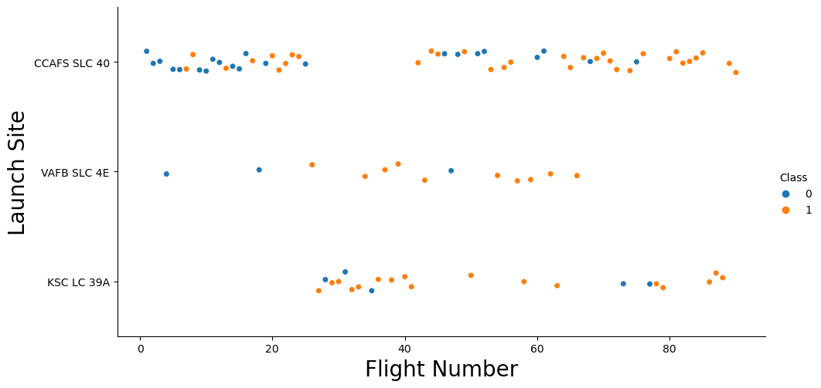
Flight Number vs. Launch Site
Insights from the plot
Earlier flights had a lower success rate (blue = fail).
Later flights had a higher success rate (orange = success)
CCAFS SLC 40 launch site has the most launches.
VAFB SLC 4E and KSC LC 39A have higher success rates.

Slide 18
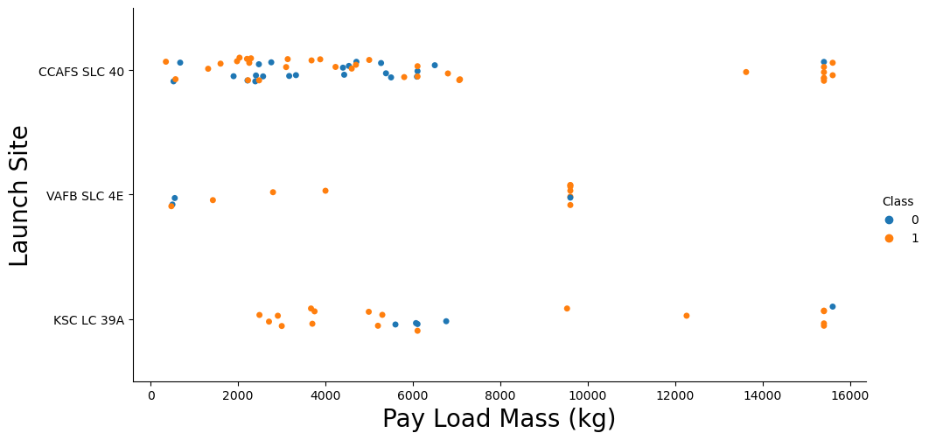
Payload vs. Launch Site
Insights from the plot
The heavier payload mass of launches seems to have a higher success rate.
KSC LC 39A has a 100% success rate for launches less than 5500 kg.
There is no clear correlation between payload mass and success rate.

Slide 19
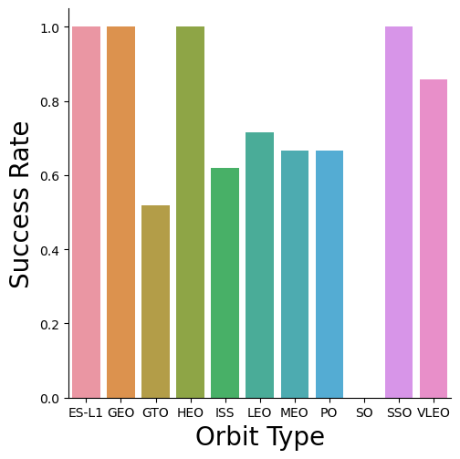
Success Rate vs. Orbit Type
Insights from the plot
100% success rate
ES-L1
GEO
HEO
SSO
0% Success Rate
SO

Slide 20
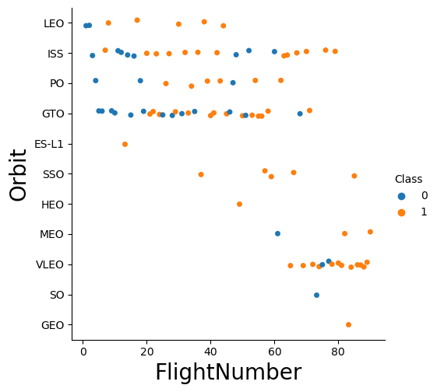
Flight Number vs. Orbit Type
Insights from the plot
The high success rate of the GEO, HEO, and ES-L1 orbits can be explained by only one flight into the respective orbits.
Generally, the success rate increases with the number of flights for each orbit.

Slide 21
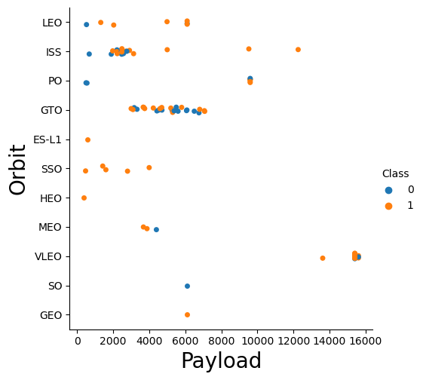
Payload vs. Orbit Type
Insights from the plot
Heavy payloads are better with LEO, ISS and PO orbits.
The GTO orbit has an unclear relationship between payload mass and success rate.

Slide 22
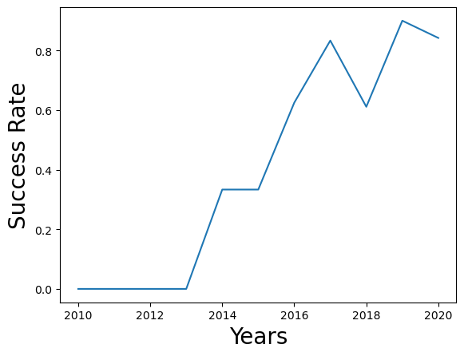
Launch Success Yearly Trend
Insights from the plot
No landings were successful from 2010 to 2013.
The success rate improved from 2013 to 2017 and 2018 to 2019.
The success rate decreased from 2017 to 2018 and 2019 to 2020.
The success rate has improved overall since 2013.

Slide 23
All Launch Site Names
Find the names of the unique launch sites
Present your query result with a short explanation here

Slide 24
Launch Site Names Begin with 'CCA'
Find 5 records where launch sites begin with `CCA`
Present your query result with a short explanation here

Slide 25
Total Payload Mass
Calculate the total payload carried by boosters from NASA
Present your query result with a short explanation here

Slide 26
Average Payload Mass by F9 v1.1
Calculate the average payload mass carried by booster version F9 v1.1
Present your query result with a short explanation here

Slide 27
First Successful Ground Landing Date
Find the dates of the first successful landing outcome on ground pad
Present your query result with a short explanation here

Slide 28
Successful Drone Ship Landing with Payload between 4000 and 6000
List the names of boosters which have successfully landed on drone ship and had payload mass greater than 4000 but less than 6000
Present your query result with a short explanation here

Slide 29
Total Number of Successful and Failure Mission Outcomes
Calculate the total number of successful and failure mission outcomes
Present your query result with a short explanation here

Slide 30
Boosters Carried Maximum Payload
List the names of the booster which have carried the maximum payload mass
Present your query result with a short explanation here

Slide 31
2015 Launch Records
List the failed landing_outcomes in drone ship, their booster versions, and launch site names for in year 2015
Present your query result with a short explanation here

Slide 32
Rank Landing Outcomes Between 2010-06-04 and 2017-03-20
Rank the count of landing outcomes (such as Failure (drone ship) or Success (ground pad)) between the date 2010-06-04 and 2017-03-20, in descending order
Present your query result with a short explanation here

Slide 33

Section 3

Slide 34
<Folium Map Screenshot 1>
Replace <Folium map screenshot 1> title with an appropriate title
Explore the generated folium map and make a proper screenshot to include all launch sites’ location markers on a global map
Explain the important elements and findings on the screenshot

Slide 35
<Folium Map Screenshot 2>
Replace <Folium map screenshot 2> title with an appropriate title
Explore the folium map and make a proper screenshot to show the color-labeled launch outcomes on the map
Explain the important elements and findings on the screenshot

Slide 36
<Folium Map Screenshot 3>
Replace <Folium map screenshot 3> title with an appropriate title
Explore the generated folium map and show the screenshot of a selected launch site to its proximities such as railway, highway, coastline, with distance calculated and displayed
Explain the important elements and findings on the screenshot

Slide 37

Section 4

Slide 38
<Dashboard Screenshot 1>
Replace <Dashboard screenshot 1> title with an appropriate title
Show the screenshot of launch success count for all sites, in a piechart
Explain the important elements and findings on the screenshot

Slide 39
<Dashboard Screenshot 2>
Replace <Dashboard screenshot 2> title with an appropriate title
Show the screenshot of the piechart for the launch site with highest launch success ratio
Explain the important elements and findings on the screenshot

Slide 40
<Dashboard Screenshot 3>
Replace <Dashboard screenshot 3> title with an appropriate title
Show screenshots of Payload vs. Launch Outcome scatter plot for all sites, with different payload selected in the range slider
Explain the important elements and findings on the screenshot, such as which payload range or booster version have the largest success rate, etc.

Slide 41

Section 5

Slide 42
Classification Accuracy
Visualize the built model accuracy for all built classification models, in a bar chart
Find which model has the highest classification accuracy

Slide 43
Confusion Matrix
Show the confusion matrix of the best performing model with an explanation

Slide 44
Conclusions
Point 1
Point 2
Point 3
Point 4
…

Slide 45
Appendix
Include any relevant assets like Python code snippets, SQL queries, charts, Notebook outputs, or data sets that you may have created during this project

Slide 46


